Slide 1
Properties of Convergent Series

Slide 2
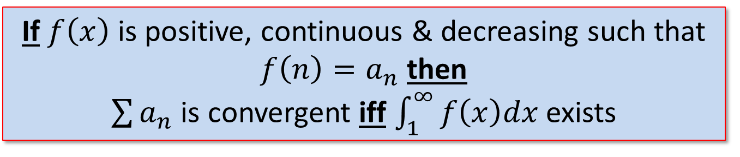
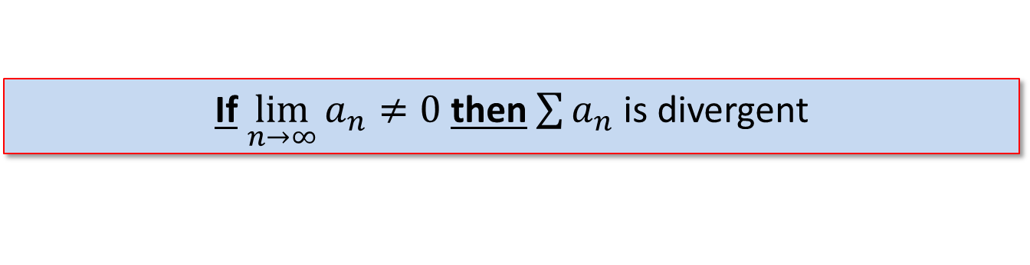
Divergence and Integral Test
Divergence Test
If $\lim_{n→∞}{a_{n}≠0}$ then $\sum{a_{n}}$ is divergent
Integral Test
If $f\left(x\right)$ is positive, continuous & decreasing such that $f\left(n\right)=a_{n}$ then
$\sum{a_{n}}$ is convergent iff $\int_{1}^{∞}{f\left(x\right)dx}$ exists

Slide 3

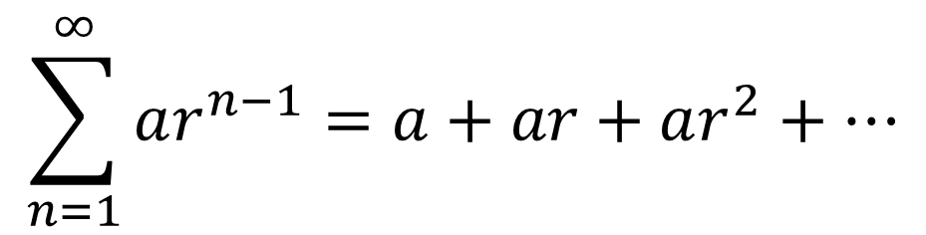

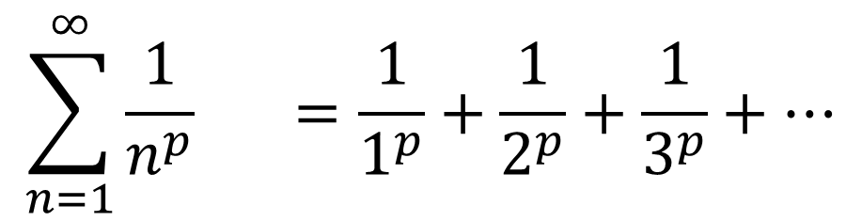

Specific Series
$$\sum_{n=1}^{∞}{ar^{n−1}}=a+ar+ar^{2}+⋯$$
Geometric Series:
Geometric converges to $\frac{a}{1−r}$ when $−1<r<1$
$$\sum_{n=1}^{∞}{\frac{1}{n^{p}}} =\frac{1}{1^{p}}+\frac{1}{2^{p}}+\frac{1}{3^{p}}+⋯$$
$p$-Series:
$p$-series converges when $p>1$

Slide 4
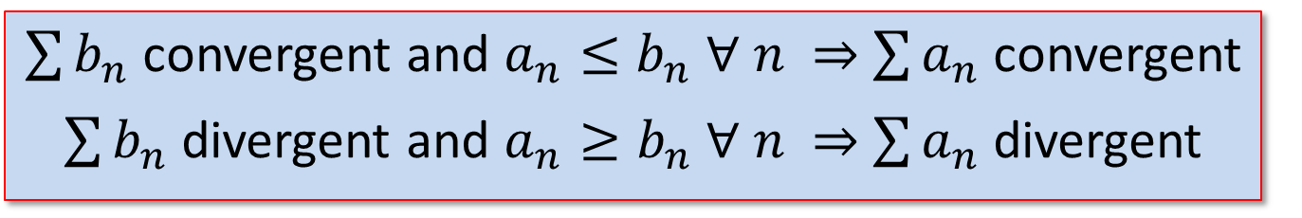


Comparison Tests
Comparison Test
$\sum{b_{n}}$ convergent and $a_{n}≤b_{n}$ $∀$ $n$ $\sum{a_{n}}$ convergent $\sum{b_{n}}$ divergent and $a_{n}≥b_{n}$ $∀$ $n$ $\sum{a_{n}}$ divergent
Limit Comparison Test
Suppose $\sum{a_{n}}$ and $\sum{b_{n}}$ are series with positive terms. If
$$\lim_{n→∞}{\frac{a_{n}}{b_{n}}}=c$$
Then either both series converge or both diverge.

Slide 5

Alternating Series
An alternating series $\sum{{(−1)}^{n−1}b_{n}}$ is convergent if
$i) b_{n+1}≤b_{n} ∀n$
$$ii) \lim_{n→∞}{b_{n}=0}$$

Slide 6
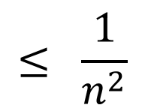
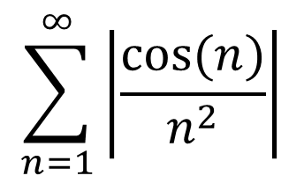
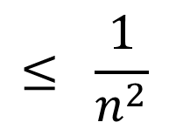
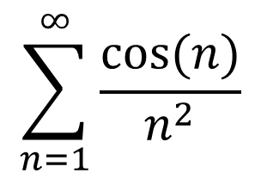
Absolute Convergence
If $\sum{\left|a_{n}\right|}$ is convergent, then $\sum{a_{n}}$ is absolutely convergent
If $\sum{a_{n}}$ is absolutely convergent, then $\sum{a_{n}}$ is convergent
$$\sum_{n=1}^{∞}{\frac{cos⁡(n)}{n^{2}}}$$
?
$$\sum_{n=1}^{∞}{\left|\frac{cos⁡(n)}{n^{2}}\right|}$$
$$≤ \frac{1}{n^{2}}$$
$$≤ \frac{1}{n^{2}}$$
?

Slide 7

Strategy for Testing Series
1. Do the terms not go to zero?
2. Is it a p-series or geometric series?
3. Is it similar to p- or geometric series?
4. Is it Alternating?
5. Does it involve factorials, or constants raised to the n^{th}?
6. Are the terms ${\left(Some Term\right)}^{n}$?
7. If $a_{n}=f\left(n\right)$ is $\int_{1}^{∞}{f(x)}dx$ easily solved?
Divergence
Test P or r
Comparison
Alternating
Ratio
Root
Integral

Slide 8

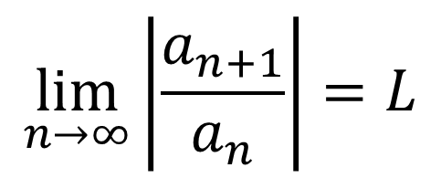
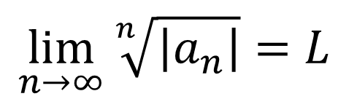
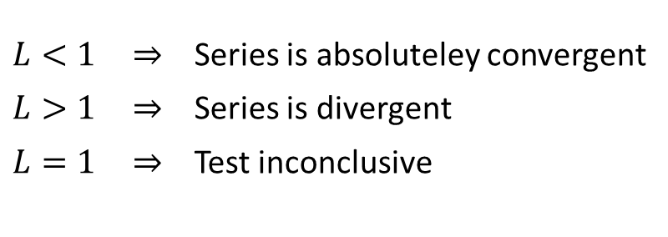
The Ratio & Root Tests
If for a given the series $\sum{a_{n}}$
$$\lim_{n→∞}\left|\frac{a_{n+1}}{a_{n}}\right|=L$$
OR
$$\lim_{n→∞}{\sqrt[n]{\left|a_{n}\right|}}=L$$
$L<1 \overset{⇒}{}$ Series is absoluteley convergent
$L>1 \overset{⇒}{}$ Series is divergent
$L=1 \overset{⇒}{}$ Test inconclusive

Slide 9
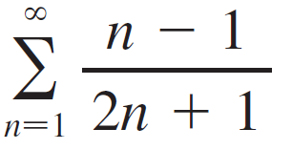

Example 1
Since as a_{n} → ≠ 0 as n → , we should use the Test for Divergence.

Slide 10

Example 2
Since a_{n} is an algebraic function of n, we compare the given series with a p-series.
The comparison series for the Limit Comparison Test is

Slide 11
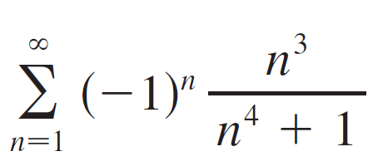
Example 4
Since the series is alternating, we use the Alternating Series Test.

Slide 12
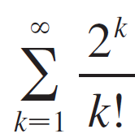
Example 5
Since the series involves k!, we use the Ratio Test.

Slide 13
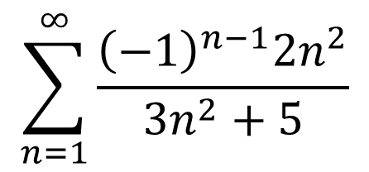
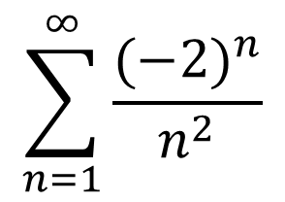
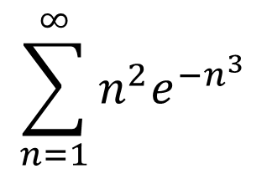
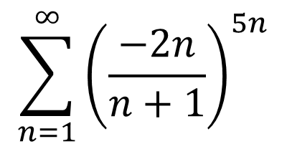
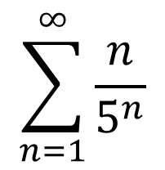
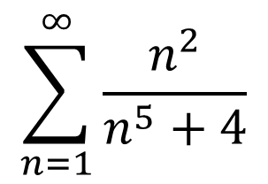
Board Work
$$\sum_{n=1}^{∞}{\frac{{(−2)}^{n}}{n^{2}}}$$
$$\sum_{n=1}^{∞}{\frac{n}{5^{n}}}$$
$$\sum_{n=1}^{∞}{{\left(\frac{−2n}{n+1}\right)}^{5n}}$$
$$\sum_{n=1}^{∞}{\frac{n^{2}}{n^{5}+4}}$$
$$\sum_{n=1}^{∞}{n^{2}e^{{−n}^{3}}}$$
$$\sum_{n=1}^{∞}{\frac{{\left(−1\right)}^{n−1}2n^{2}}{{3n}^{2}+5}}$$
Notes:
Convergent by Ratio/Alt
Convergent by Ratio
Divergent by Root
Convergent by Comparison
Convergent by Integral
Divergent by Divergence

